Slide 1
Machine Learning (ML)
“Teaching Machines to Learn from Data”
Presented by: Urvashi Zinzuvadiya

Slide 2
What is Machine Learning?
Machine Learning is a branch of Artificial Intelligence (AI).
It allows computers to learn from data.
Machines can make predictions or decisions without being explicitly programmed for every task.
ML improves its performance when it gets more data.
Example: YouTube recommending videos based on your watching history.

Slide 3
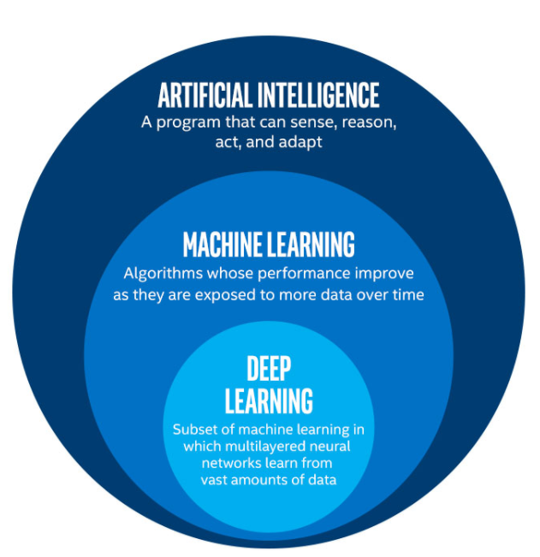
AI vs ML vs Deep Learning
AI: Broad concept of making machines intelligent.
ML: A subset of AI that learns from data.
Deep Learning: A subset of ML using neural networks with many layers.
This Photo by Unknown Author is licensed under CC BY-SA

Slide 4
How Does Machine Learning Work?
Collect data
Clean and prepare data
Select important features
Train the ML model
Test the model
Make predictions
Improve the model
Simple flow:
Data → Training → Model → Prediction

Slide 5
Types of Machine Learning
There are mainly three types:
Supervised Learning
Unsupervised Learning
Reinforcement Learning
Each type learns in a different way depending on the available data and problem.

Slide 6
Supervised Learning
Model learns from labeled data.
Input and correct output are already known.
Used for prediction and classification.
Examples:
Spam email detection
House price prediction
Disease prediction
Algorithms: Linear Regression, Decision Tree, KNN, SVM

Slide 7
Unsupervised Learning
Model works with unlabeled data.
It finds hidden patterns or groups in data.
Examples:
Customer segmentation
Grouping similar products
Finding unusual behavior
Algorithms: K-Means, Hierarchical Clustering

Slide 8
Reinforcement Learning
Machine learns through trial and error.
It receives:
  Reward for good actions
  Penalty for bad actions
Examples:
Game-playing AI
Robots
Self-driving systems
Concept:
Action → Reward/Penalty → Learning

Slide 9
Common ML Algorithms
Some popular algorithms are:
Linear Regression
Logistic Regression
Decision Tree
Random Forest
K-Nearest Neighbors (KNN)
Support Vector Machine (SVM)
K-Means Clustering
Neural Networks

Slide 10
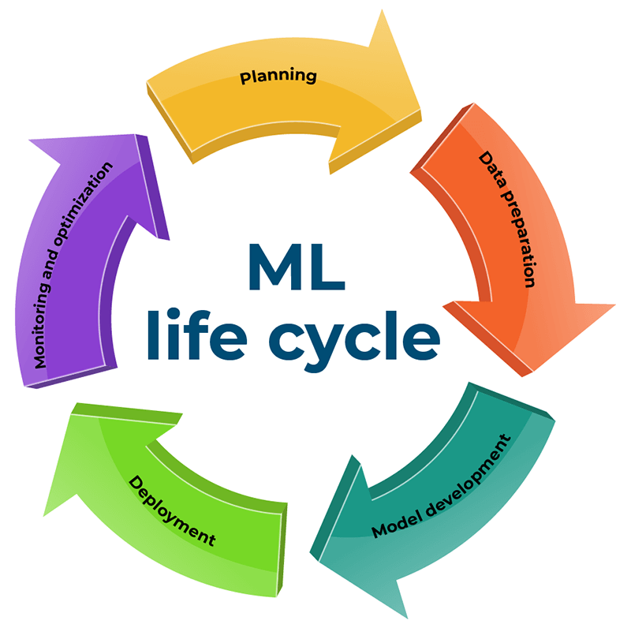
Machine Learning in Daily Life
ML is already used in many applications:
Netflix: Movie recommendations
YouTube: Video recommendations
Google: Search results
Google Maps: Traffic prediction
Email: Spam detection
Online Shopping: Product recommendations
Face Recognition: Identifying people

Slide 11
Applications of ML
Healthcare
Disease detection
Medical image analysis
Finance
Fraud detection
Credit risk analysis
Education
Personalized learning
Student performance prediction
Transportation
Traffic prediction
Autonomous vehicles
Manufacturing
Detecting defects in products
Improving production efficiency

Slide 12
Advantages of Machine Learning
Automates repetitive tasks
Can analyze huge amounts of data
Helps make faster decisions
Finds patterns that humans may miss
Improves with more quality data
Useful for prediction and personalization

Slide 13
Challenges & Limitations
Requires a large amount of quality data
Training can be expensive
Incorrect data can produce incorrect results
Models can sometimes be biased
Some models are difficult to explain
Privacy and security can be concerns

Slide 14
Future of Machine Learning
ML will continue to grow in areas such as:
Generative AI
Healthcare
Robotics
Smart cities
Autonomous vehicles
Cybersecurity
Personalized education
Business automation
Future goal: Making systems more accurate, useful and responsible.

Slide 15
Conclusion
Machine Learning is an important part of modern technology.
It enables computers to learn from data.
ML is used in everyday applications as well as advanced industries.
Understanding ML is becoming an important skill for the future.
“Machine Learning is not about programming machines to do everything; it is about enabling machines to learn from experience.”

Slide 16
Thank You 😀

